Slide 1


Plant Genesis
Your Journey to Botanical Innovation Starts Here
Candidates :
Koshika T
Kirthik Kumar S
Gokulnath N
Department Of Computer Science & Design
SNS College Of Engineering, Coimbatore

Slide 2


Introduction
The lack of awareness surrounding Plant Patents and the associated patenting processes represents a critical knowledge gap.
This thesis aims to investigate the root causes of this deficiency and propose strategies to enhance public education, fostering a more informed and innovation-driven landscape in plant breeding and agriculture.
For this we have come with a solution to address the lack of awareness about Plant Patents and patenting processes by developing an informative website.

Slide 3

Empathy
Thinks
No difficult options
are used which
make harder to
understand for
people
Says
People can easily
understand if
it is patent able
CUSTOMER
Does
Avoid spam calls,
message
and emails
Feels
Can be able to set
understandable
language which
people want

Slide 4

Objective
The objective is to facilitate the patenting process for innovators by providing comprehensive guidance through our dedicated website.
By offering clear and accessible paths, the platform aims to empower individuals to successfully navigate the intricacies of patenting, ensuring that their innovations and inventions receive the necessary protection.
The goal is to enhance accessibility and streamline the patent application journey, fostering a more innovation-friendly environment.

Slide 5
Define
We’ve addressed the lack of awareness about Plant Patents through an informative website. This user-friendly guide consolidates diverse registration methods, easing the stress of the patenting process.
Our platform empowers individuals to efficiently navigate and understand plant patent intricacies. The objective is to facilitate patenting for innovators by providing comprehensive guidance.
With clear paths, the platform ensures that innovations receive necessary protection, enhancing accessibility and streamlining the patent application journey. Our goal is to foster a more innovation-friendly environment.

Slide 6
Ideate
The primary objective of this project is to design and implement a dynamic website that fulfils specific user requirements.
The website will be developed using HTML for structuring, CSS for styling and JavaScript for enhancing user interactivity.
Google Apps Script will be employed to handle server-side functionalities and interactions with Google services, allowing for a streamlined and efficient web application.

Slide 7
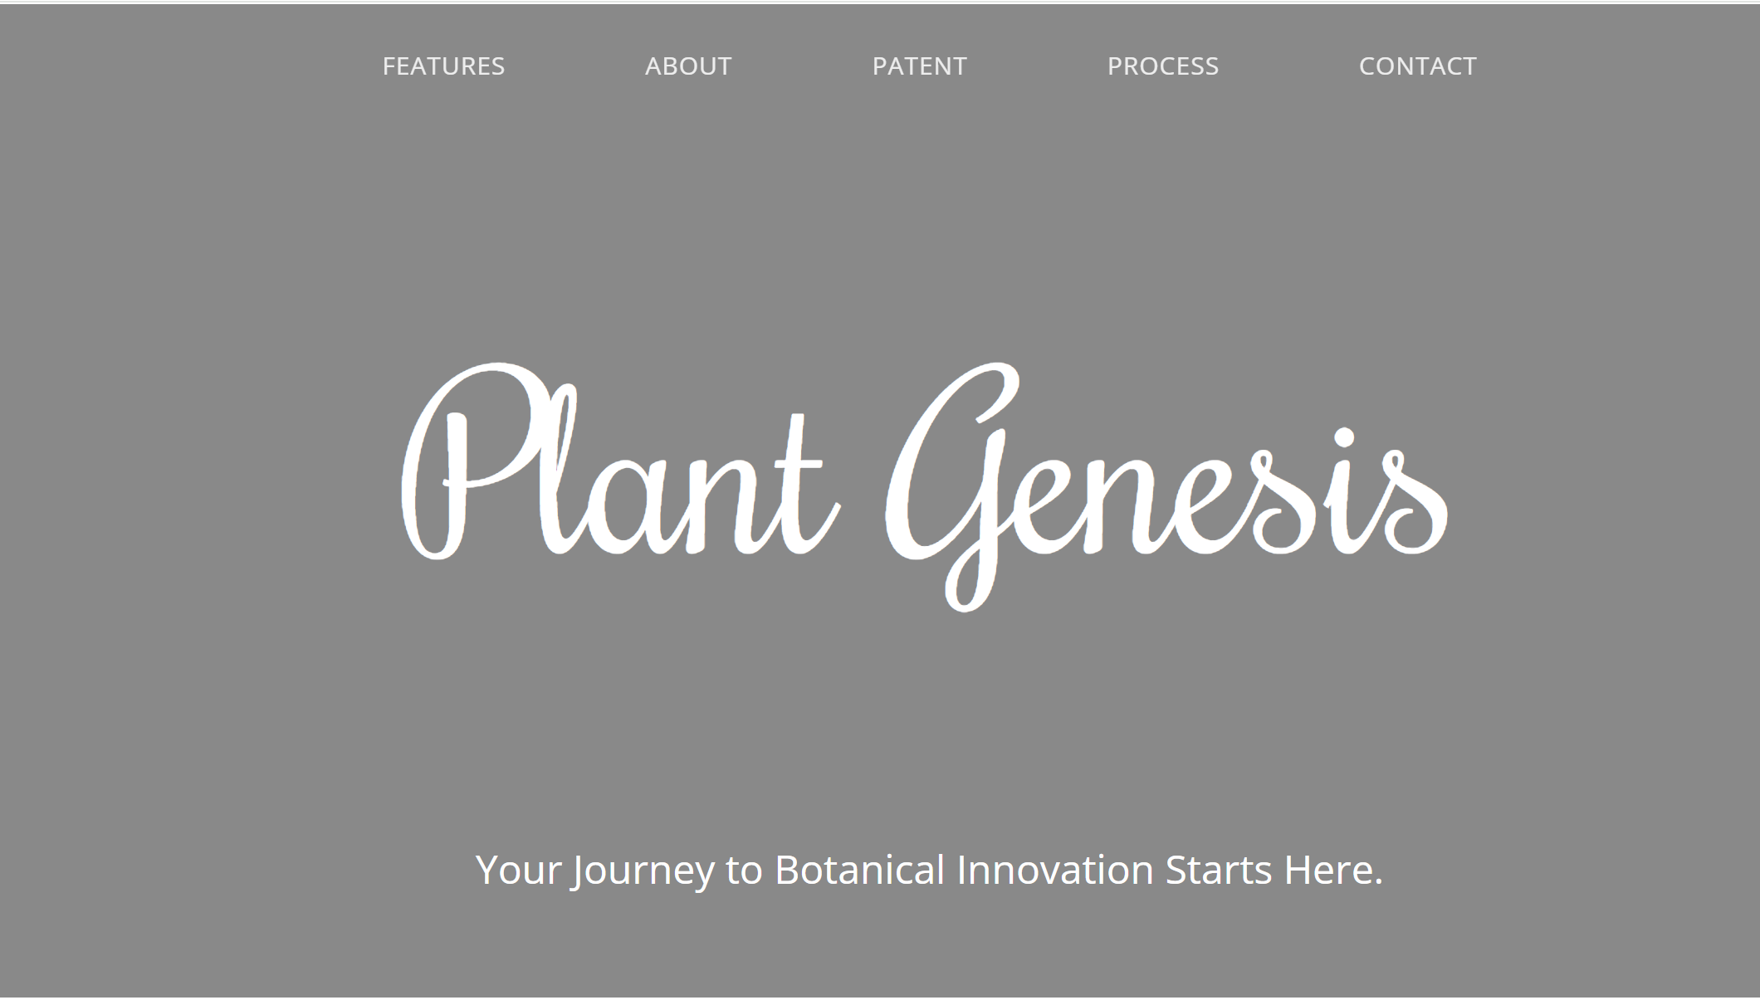
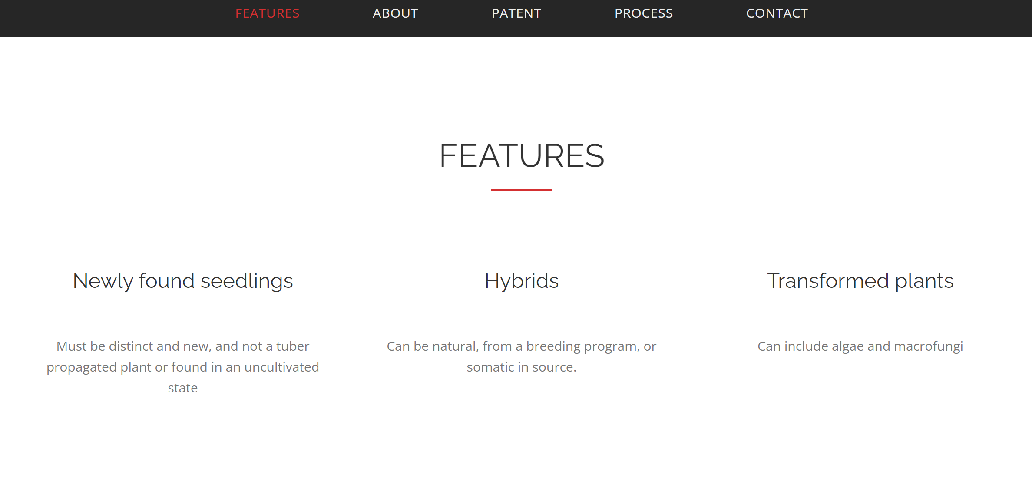
Prototype

Slide 8
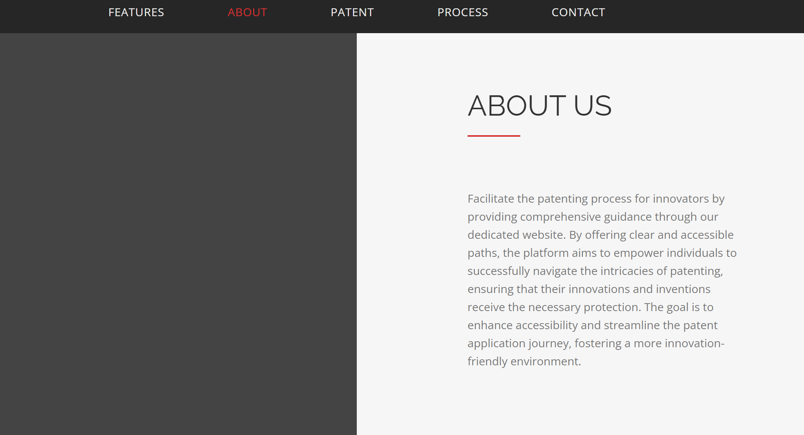
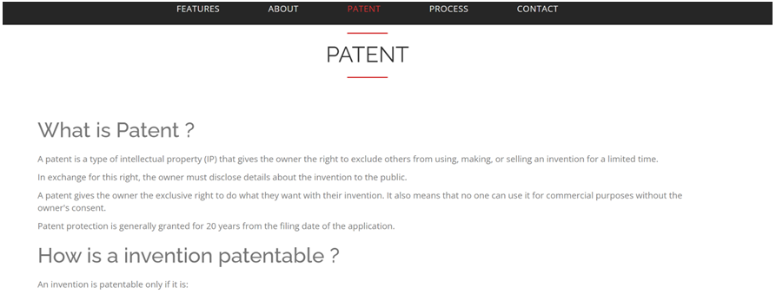
Prototype

Slide 9
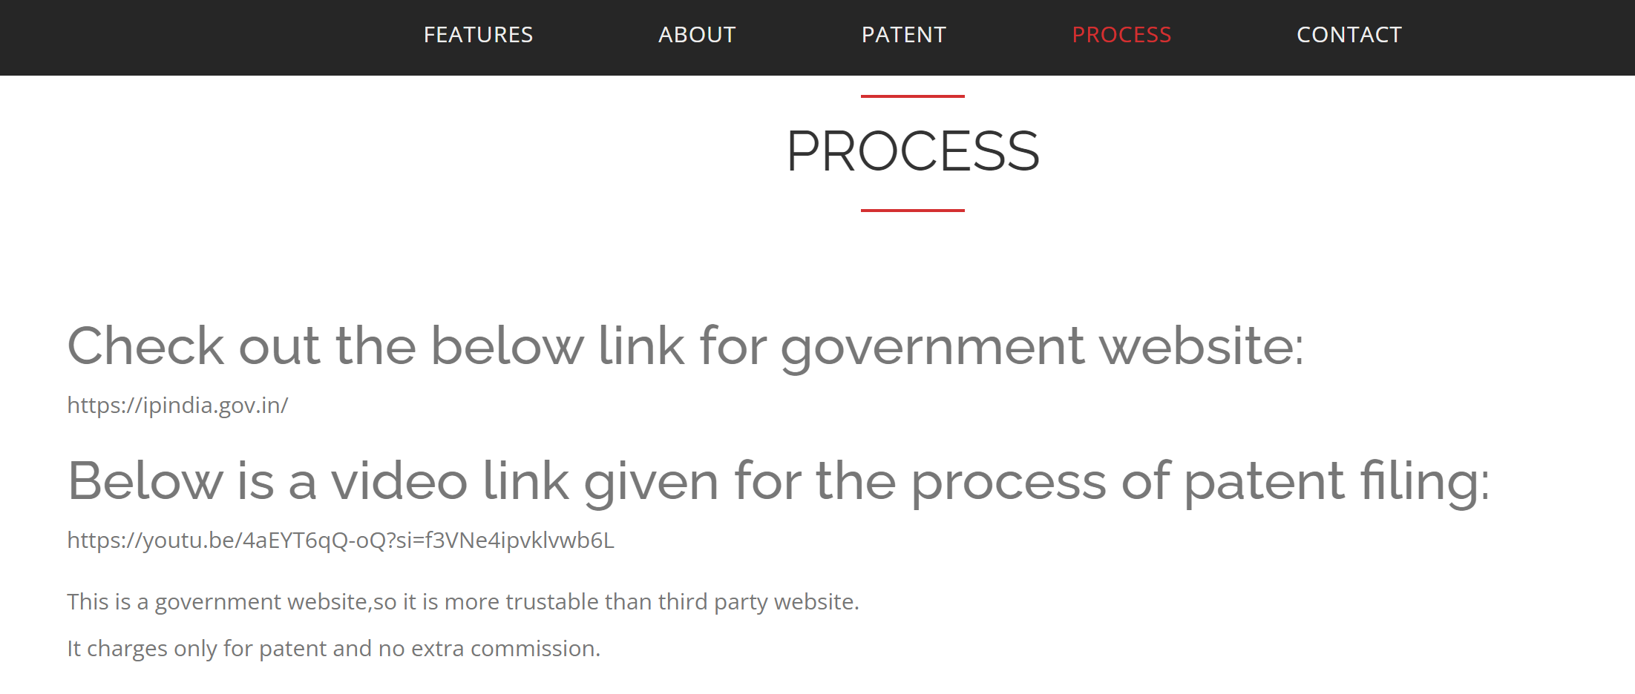
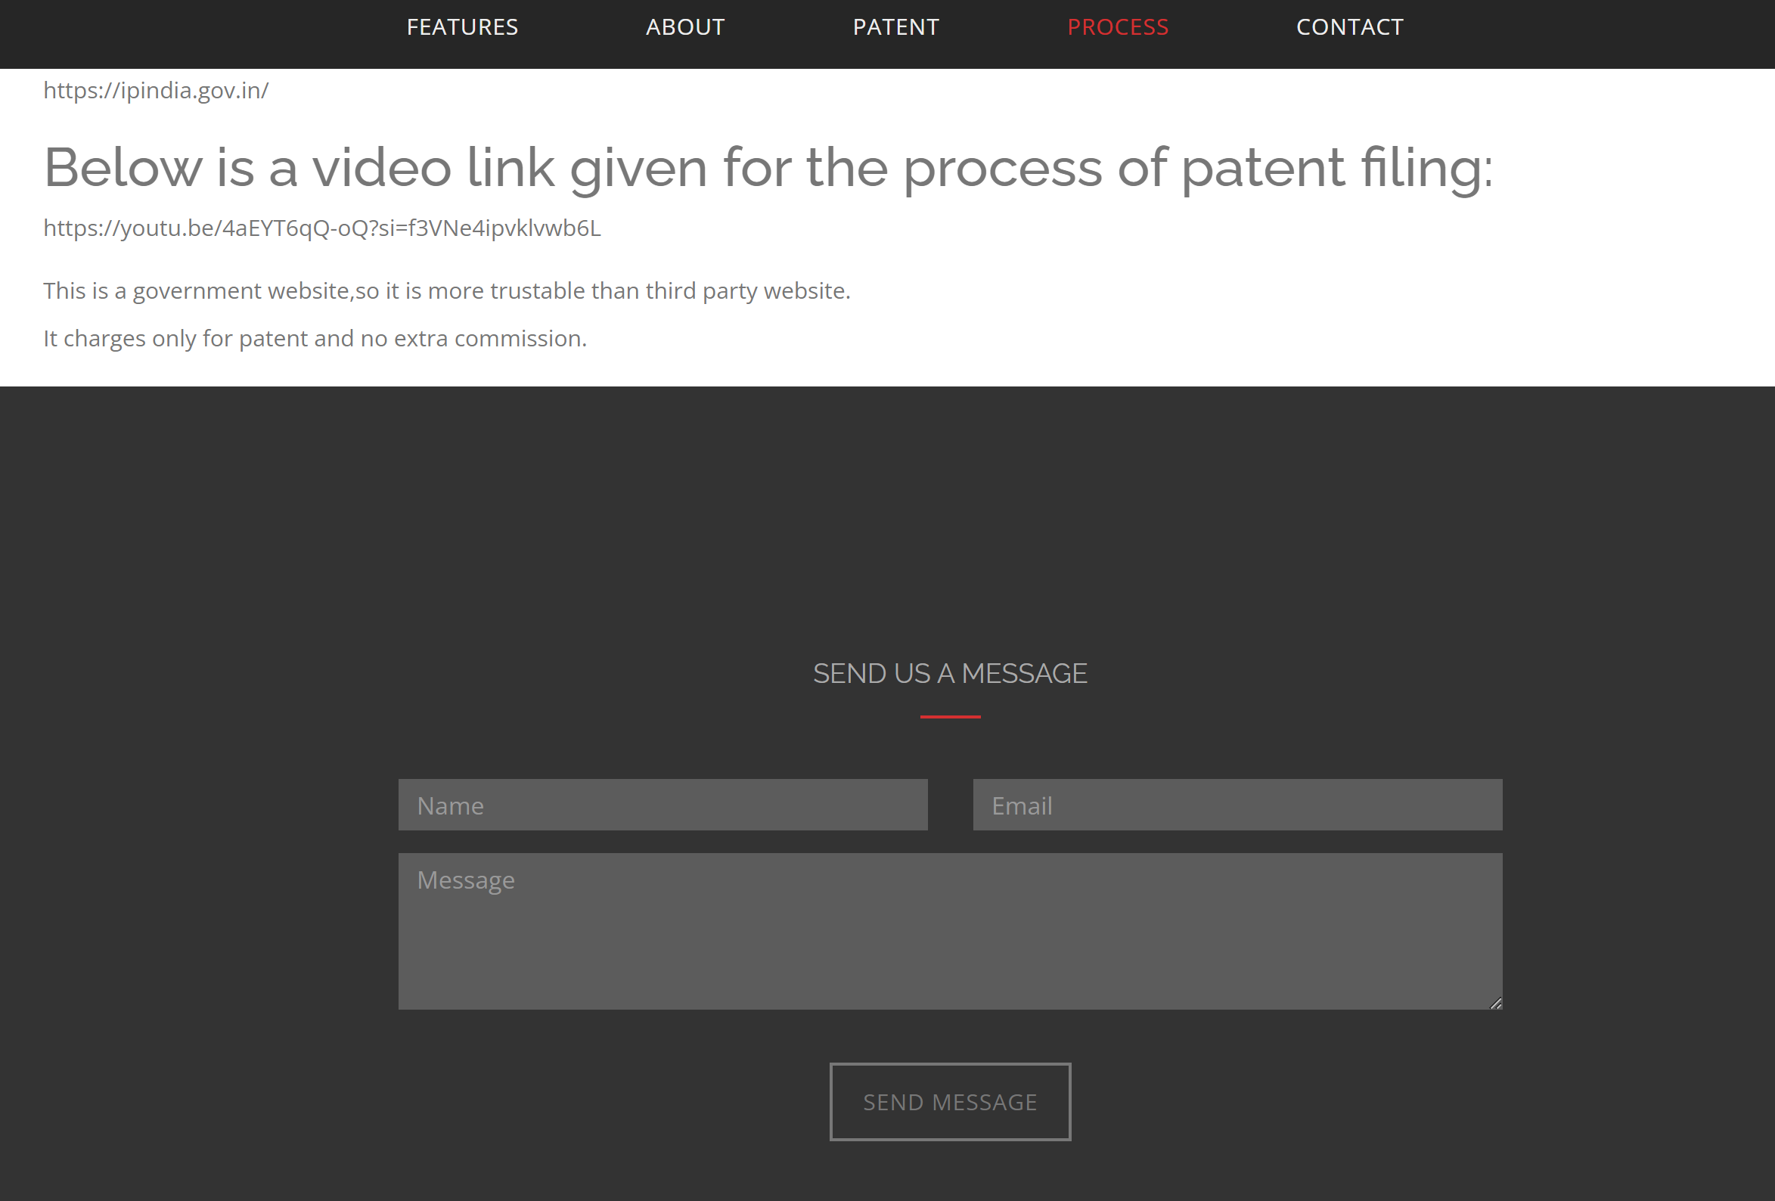
Prototype

Slide 10
Methodology
Get inputs from user
Answer the mails
Give the results to people

Slide 11
Conclusion
In conclusion, it undergoes the pivotal role of patenting in safeguarding a myriad of ideas.
By facilitating the patenting process, the research contributes to the protection of intellectual property, fostering a conducive environment for innovation.
Ultimately, this initiative not only preserves existing ideas but also actively promotes the introduction of novel concepts, thereby enriching the intellectual landscape for the benefit of society at large.

Slide 12

THANK YU

